Slide 1

VETERINARY ANATOMY

Slide 2
Definition: Study of the structure of animals, including systems, organs, and tissues.
Categories:
  Macroscopic (Gross) Anatomy: Structures visible to the naked eye.
  Microscopic Anatomy (Histology): Structures at the cellular and tissue level.
Branches of Veterinary Anatomy
Comparative Anatomy: Differences and similarities among species.
Developmental Anatomy (Embryology): Development from a single cell to a fetus.
Histology: Microscopic structure of tissues and organs.
Neuroanatomy: Structure and function of the nervous system.
Osteology: Study of bones and the skeletal system.
Splanchnology: Anatomy of internal organs (digestive, respiratory, urinary, reproductive).
Syndesmology: Structure and function of joints and ligaments.
Angiology: Anatomy of the circulatory system (arteries, veins, lymphatics).

Slide 3
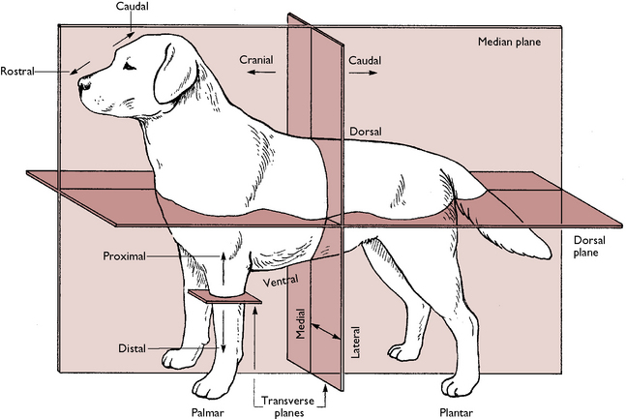
Descriptive Terms in Veterinary Anatomy
Dorsal: Toward the back.
Ventral: Toward the belly.
Cranial: Toward the head.
Caudal: Toward the tail.
Medial: Closer to the midline.
Lateral: Further from the midline.
Proximal: Closer to the point of attachment.
Distal: Further from the point of attachment.
Anatomical Planes
Sagittal Plane: Divides the body into left and right parts.
Frontal (Coronal) Plane: Divides the body into dorsal and ventral sections.
Transverse (Horizontal) Plane: Divides the body into cranial and caudal parts.

Slide 4
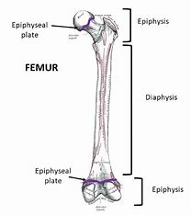
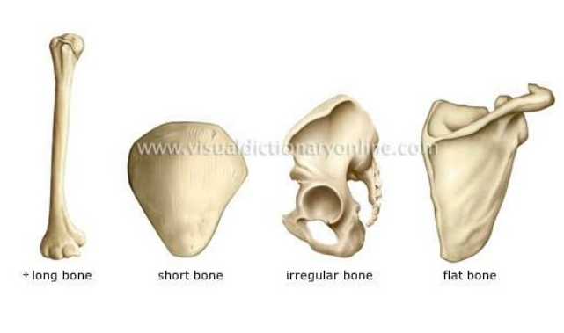
General Osteology
Bone Composition
Organic components: collagen, ground substance
Bone Types
Compact bone: dense outer layer
Appendicular skeleton: limbs and girdles
Inorganic components: hydroxyapatite
Cancellous (spongy) bone: porous inner layer
Classification of Skeletons
Axial skeleton: skull, vertebral column, ribs, sternum
Classification of Bones
Long bones: femur, humerus, tibia
Short bones: carpals, tarsals
Flat bones: scapula, skull, pelvis
Irregular bones: vertebrae
Sesamoid bones: patella
Osteology Terminology
Diaphysis: shaft of long bone
Epiphysis: ends of long bones
Metaphysis: region between diaphysis
and epiphysis
Articulation: joint between bones

Slide 5
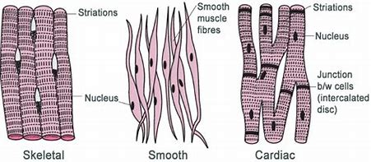
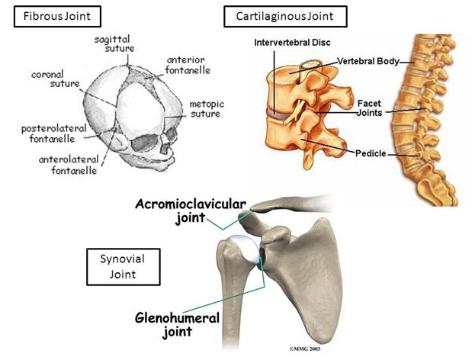
Introduction to Arthrology
Classification of Joints
Fibrous joints: immovable (e.g., skull sutures)
Cartilaginous joints: slightly movable (e.g., intervertebral discs)
Synovial joints: freely movable (e.g., knee, elbow)
Diarthrodial Joints
Components: articular cartilage, synovial fluid, joint capsule, ligaments
Movements: flexion/extension, abduction/adduction, rotation
Introduction to Myology
Classification of Muscles
Skeletal muscle: voluntary, striated, attached to bones
Cardiac muscle: involuntary, striated, found in the heart
Smooth muscle: involuntary, non-striated, found in organs
Muscle Etymology
Names derived from Latin/Greek indicating location or function
Related Structures
Tendons: connect muscles to bones
Ligaments: connect bones to other bones
Aponeurosis: flat sheet of connective tissue
Synovial bursa: fluid-filled sacs reducing friction
Synovial sheath: protective covering around tendons

Slide 6
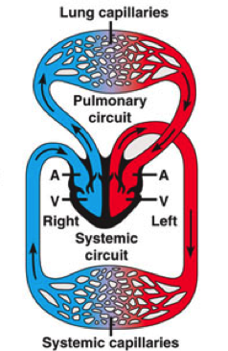
Introduction to Angiology
Definition: Study of the circulatory system (arteries, veins, lymphatic vessels).
Focus: Diagnosis, treatment, and prevention of vascular diseases.
Structure of the Heart
Components:
  Four chambers: right atrium, right ventricle, left atrium, left ventricle.
  Valves: tricuspid, pulmonary, mitral, aortic.
Function: Pumps blood throughout the body.
General Plan of Circulations
Systemic Circulation: Oxygenated blood from left ventricle to the body; deoxygenated blood returns to right atrium.
Pulmonary Circulation: Deoxygenated blood from right ventricle to lungs; oxygenated blood returns to left atrium.
Lymphatic System
Function: Transports lymph (contains white blood cells); plays a role in immune function and fluid balance.
Components: Lymphatic vessels, lymph nodes.

Slide 7
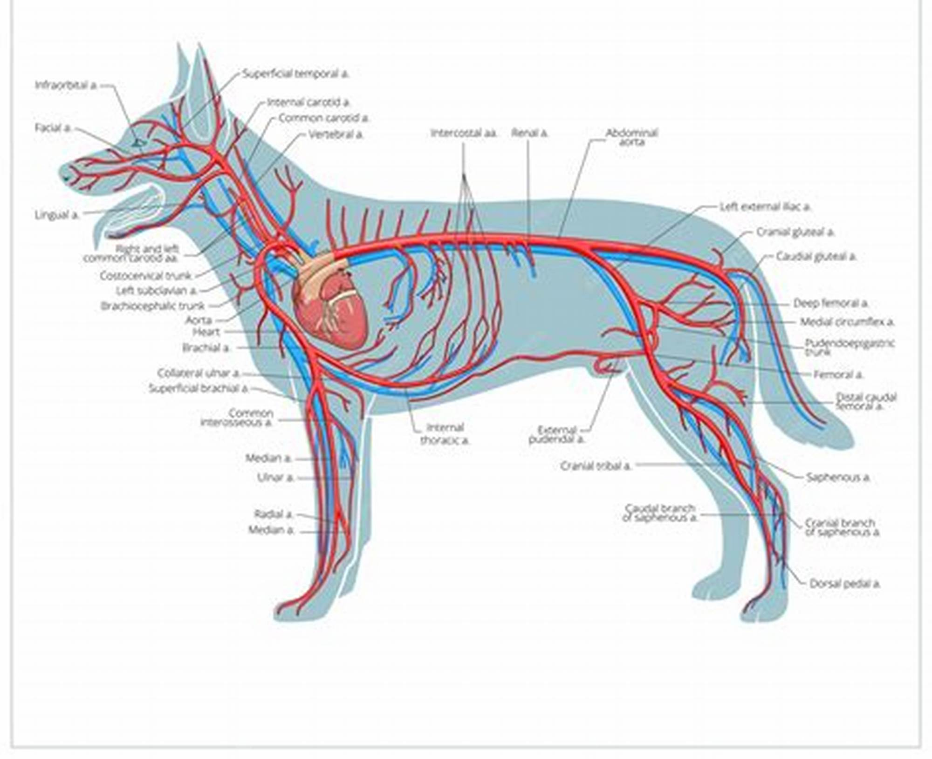
Venous System
Function: Returns deoxygenated blood to the heart.
Components: Deep veins, superficial veins, venous sinuses.
Vascular Diseases
Arterial Diseases: Atherosclerosis, narrowing, occlusion.
Lymphatic Diseases: Lymphedema.
Microcirculation Anomalies: Changes in skin temperature and color.
Vascular Medicine
Exams: Duplex ultrasound, angiography, Doppler, plethysmography.
Interventional Angiology: Endovascular catheter interventions.

Slide 8
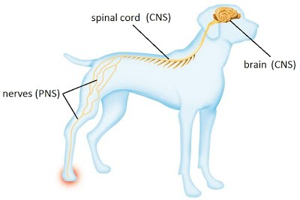
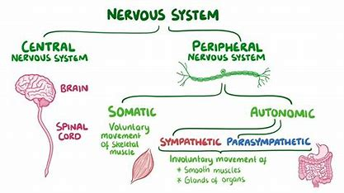
Introduction to Neurology
Central Nervous System (CNS)
Components: Brain and spinal cord.
Function: Processes sensory information; coordinates body functions.
Peripheral Nervous System (PNS)
Components: Nerves outside the CNS.
Divisions:
  Somatic Nervous System: Voluntary control.
  Autonomic Nervous System: Involuntary control.
Autonomic Nervous System
Divisions:
  Sympathetic Division: "Fight or flight" response.
  Parasympathetic Division: "Rest and digest" functions.
Sense Organs
Function: Detect stimuli; send signals to the brain.
Includes: Eyes (vision), ears (hearing), nose (smell), tongue (taste), skin (touch).

Slide 9
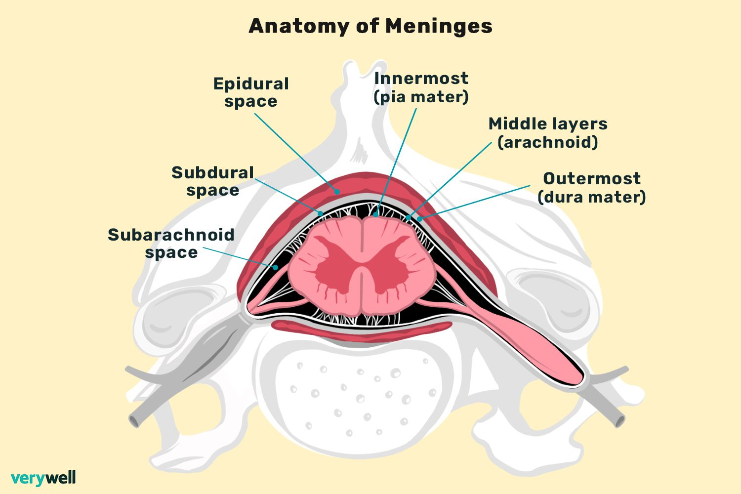
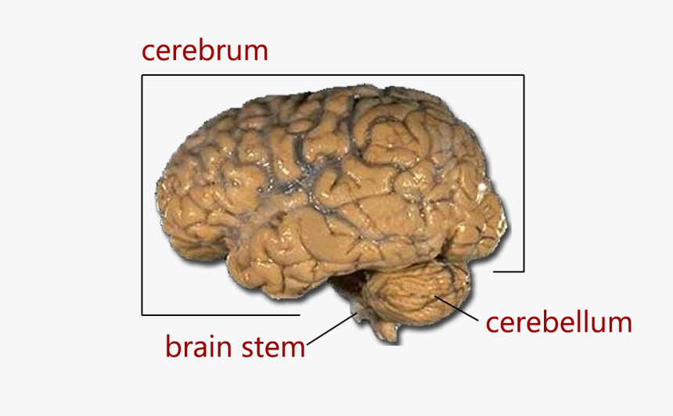
Formation of Spinal Nerve
Process: Union of sensory (dorsal) and motor (ventral) nerve roots.
Structure of Meninges
Layers:
  Dura Mater: Tough outer layer.
  Arachnoid Mater: Middle layer.
  Pia Mater: Delicate inner layer.
Structure of the Brain
Regions:
  Cerebrum: Higher brain functions (thought, memory).
  Cerebellum: Movement coordination.
  Brainstem: Basic life functions (breathing, heart rate).

Slide 10
Surface Regions and Joint Regions
Surface Regions
Cranial Region: Head and skull; assess neurological function.
Facial Region: Muzzle and eyes; check for dental issues.
Neck Regions: Dorsal, lateral, ventral; examine trachea and blood vessels.
Thoracic Regions: Presternal, sternal, costal; assess respiratory health.
Abdominal Regions: Cranial, middle, caudal; palpate organs for abnormalities.
Pelvic Region: Around the pelvis; evaluate reproductive health.
Forelimb Regions: Scapular, brachial, antebrachial, forepaw; assess limb injuries.
Hindlimb Regions: Femoral, crural, hindpaw; evaluate joint health.

Slide 11
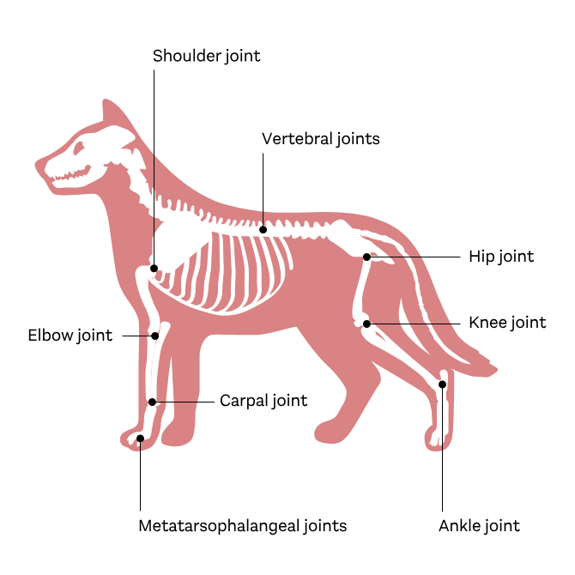
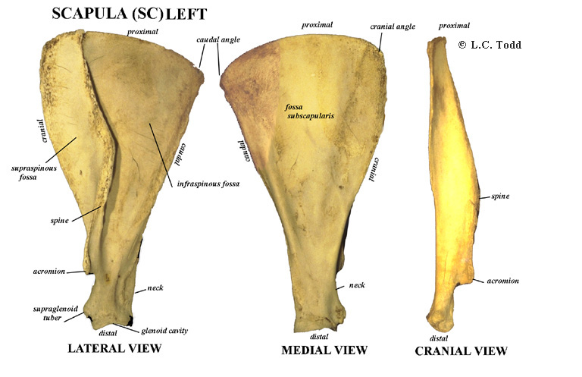
Joint Regions
Shoulder Joint: Scapula and humerus; assess mobility.
Elbow Joint: Humerus, radius, ulna; check for dysplasia.
Hip Joint: Pelvis and femur; evaluate for hip dysplasia.
Knee Joint (Stifle): Femur, tibia, patella; assess for ligament injuries.
Ankle Joint (Tarsus): Tibia, fibula, tarsal bones; evaluate mobility.
Palpable Bony Areas or Prominences
Scapula: Shoulder blade; assess shoulder injuries.
Humerus: Upper forelimb; evaluate fractures.

Slide 12
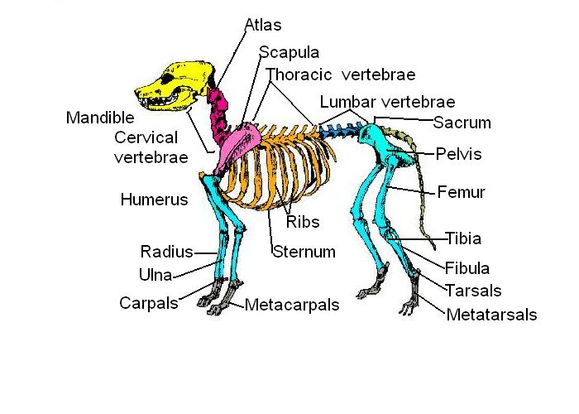
Radius and Ulna: Forearm bones; assess injuries.
Pelvis: Hip bones; evaluate reproductive health.
Femur: Thigh bone; assess hip and thigh injuries.
Tibia and Fibula: Lower leg bones; evaluate injuries.
Vertebrae: Spinal column; assess spinal injuries.
Palpable Lymph Nodes
Mandibular Lymph Nodes: Near the jaw; check for infections.
Parotid Lymph Nodes: Near the ear; evaluate for tumors.
Superficial Cervical Lymph Nodes: In the neck; assess for respiratory infections.
Superficial Inguinal Lymph Nodes: In the groin; evaluate for urinary tract infections.
Popliteal Lymph Nodes: Behind the knee; assess hind limb infections.

Slide 13
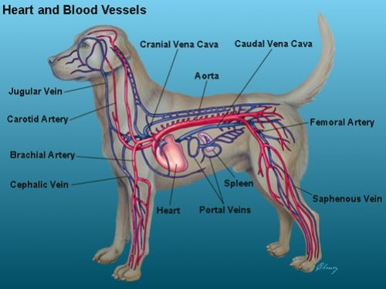
Palpable Arteries
Femoral Artery: In the groin; assess pulse and circulation.
Radial Artery: At the wrist; used for pulse assessment.
Carotid Artery: In the neck; assess pulse and blood flow.
Brachial Artery: In the upper forelimb; important for pulse assessment.
Surface Veins for Venepuncture
Cephalic Vein: In the forelimb; commonly used for blood collection.
Jugular Vein: In the neck; used for larger volume blood draws.
Saphenous Vein: In the hindlimb; used for blood collection in cats.
Femoral Vein: In the groin; utilized for blood collection in larger animals.

Slide 14
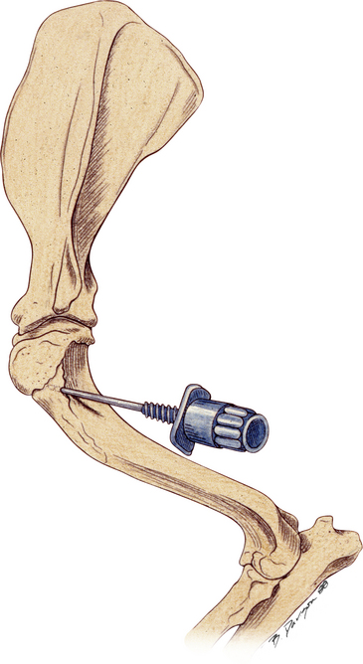
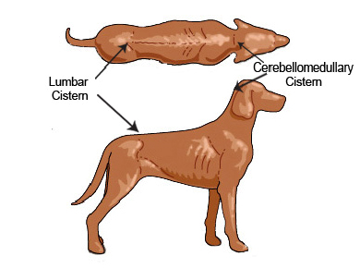
Sites for Collection of Bone Marrow
Iliac Crest: Pelvic bone; common site for aspiration.
Sternum: Breastbone; used for bone marrow collection.
Proximal Humerus: Upper forelimb; alternative site for aspiration.
Sites for Collection of Cerebrospinal Fluid (CSF)
Lumbosacral Region: Between lumbar vertebrae; common site for CSF collection.
Cisterna Magna: Base of the skull; used for CSF collection.
Atlanto-occipital Space: Between skull and first cervical vertebra; another site for CSF collection.

Slide 15
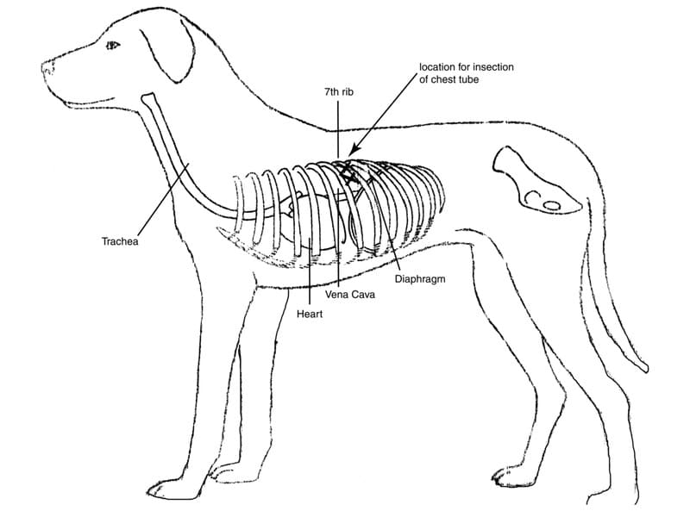
Introduction to Splanchnology
Definition: Study of internal organs (viscera) in body cavities.
Importance: Essential for understanding anatomy, physiology, and pathology of organs.
Boundaries of Body Cavities
Thoracic Cavity:
  Boundaries: thoracic inlet, diaphragm, ribs, vertebrae.
  Contents: heart, lungs, major blood vessels, trachea, esophagus.

Slide 16
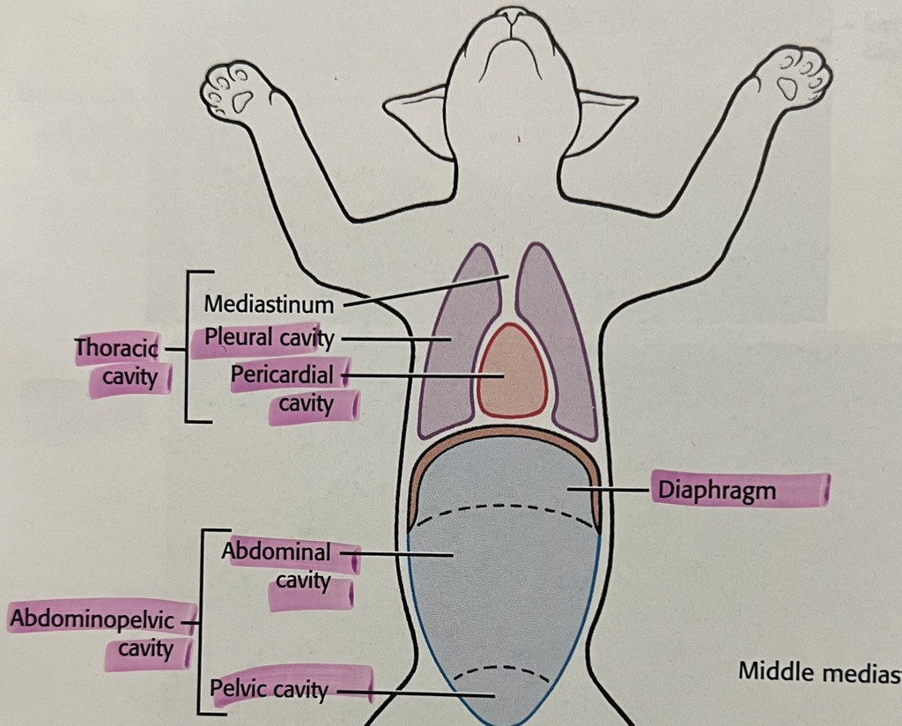
Abdominal Cavity:
  Boundaries: diaphragm, pelvic inlet, abdominal muscles, vertebrae.
  Contents: digestive organs, liver, gallbladder, pancreas, spleen, kidneys.
Pelvic Cavity:
  Boundaries: pelvic inlet, pelvic floor, pelvic bones, sacrum, coccyx.
  Contents: reproductive organs, urinary bladder, rectum.

Slide 17
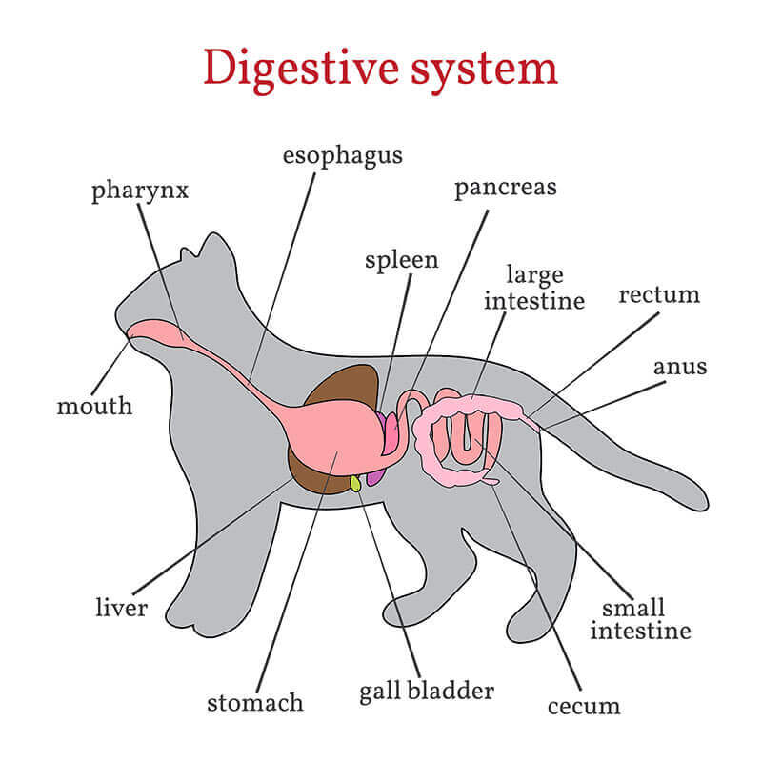
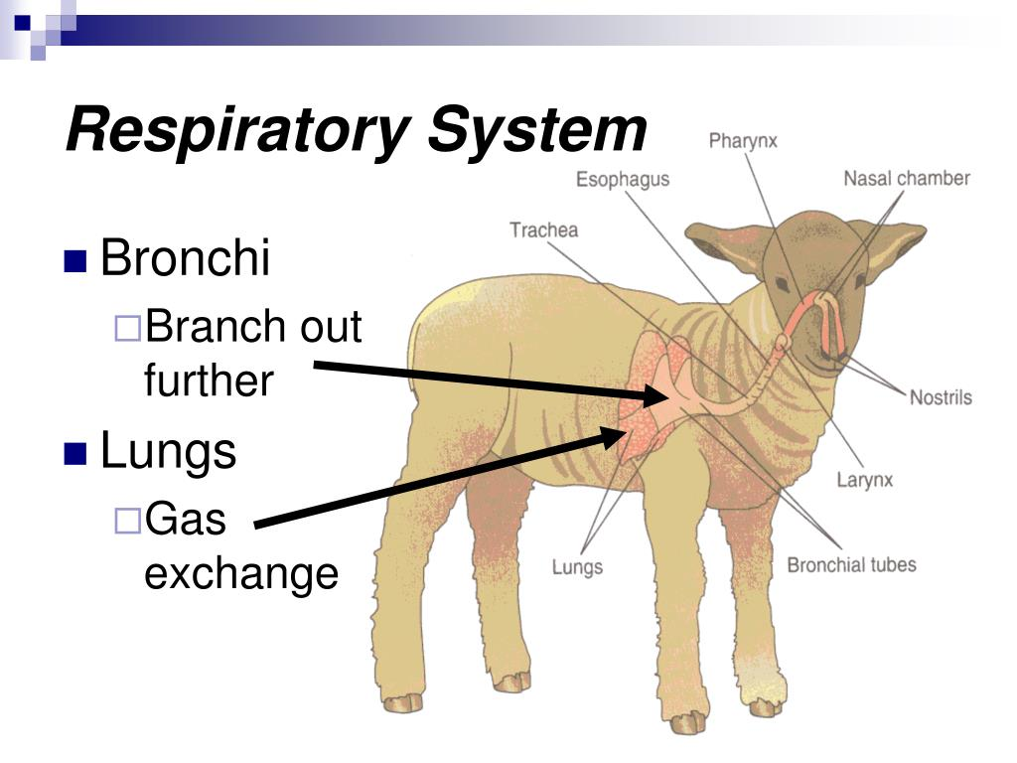
Topography of Organ Systems
Digestive System
Mouth: lips, cheeks, gums, palate, tongue, teeth.
Esophagus: transports food to stomach.
Stomach: varies in structure among species.
Intestines: small (duodenum, jejunum, ileum) and large (cecum, colon, rectum).
Accessory Organs: liver, pancreas.
Respiratory System
Nasal Cavity: filters, warms, humidifies air.
Larynx: voice production, protects trachea.
Trachea: conducts air to lungs.
Lungs: alveoli for gas exchange.

Slide 18
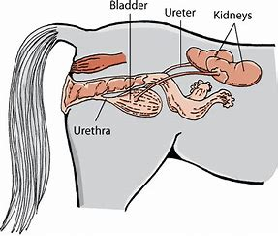
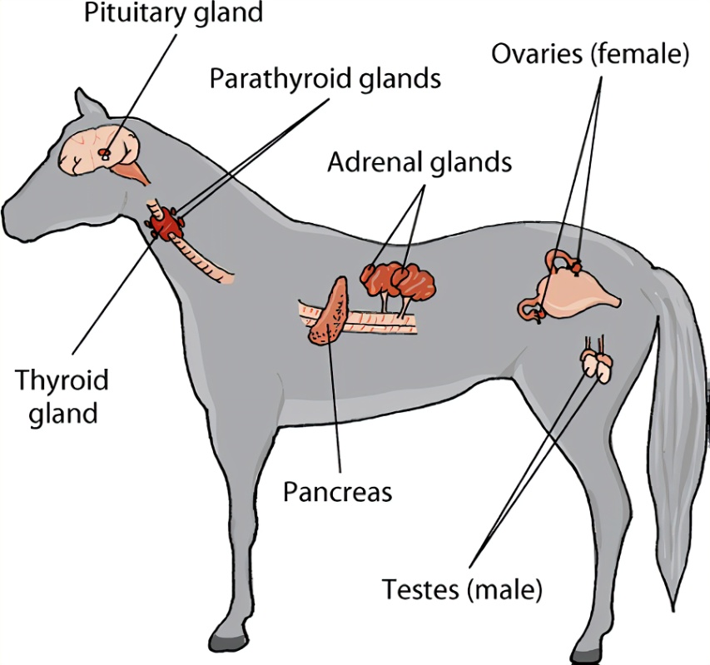
Urinary System
Kidneys: filter blood, produce urine.
Ureters: transport urine to bladder.
Urinary Bladder: stores urine.
Urethra: conducts urine out of body.
Endocrine System
Glands: pituitary, thyroid, adrenal, pancreas.
Function: regulate metabolism, growth, reproduction via hormones.
Reproductive Systems
Male: testes, epididymis, vas deferens, accessory glands.
Female: ovaries, fallopian tubes, uterus, vagina.

Slide 19
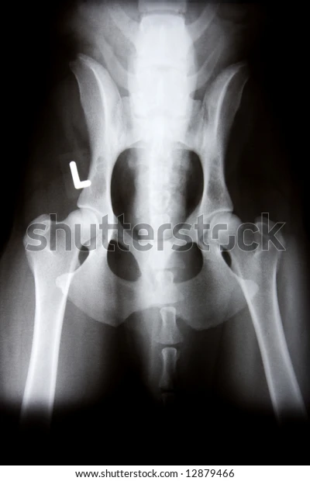
Radiography Principles
2D Representation: Produces two-dimensional images of three-dimensional structures.
Positioning and Exposure: Critical for obtaining diagnostic-quality images
Systematic Evaluation: Important to avoid missing lesions.
Applications for Bones
Fractures: Evaluate and diagnose fractures and dislocations.
Joint Assessment: Assess joint conformation and detect osteoarthritis.
Developmental Diseases: Diagnose conditions like hip and elbow dysplasia.
Applications for Soft Tissues
Thoracic Imaging: Evaluate for masses, fluid, or abnormalities in the thoracic cavity.
Abdominal Imaging: Assess for organomegaly, masses, or foreign bodies.
Soft Tissue Injuries: Diagnose muscle, tendon, and ligament injuries.

Slide 20
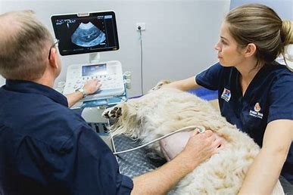
Ultrasonography Principles
High-Frequency Sound Waves: Uses sound waves to create real-time images.
Contact with Skin: Requires coupling gel for effective imaging.
Soft Tissue Detail: Excellent for soft tissue imaging; limited bone detail.
Applications for Bones
Articular Cartilage: Evaluate cartilage and subchondral bone.
Tendon and Ligament Insertions: Assess insertions on bone.
Applications for Soft Tissues
Cardiac Assessment: Evaluate the heart and great vessels.
Abdominal Organs: Assess abdominal organs for masses or fluid.
Soft Tissue Injuries: Diagnose muscle, tendon, and ligament injuries.
Guided Procedures: Assist in aspiration or biopsy procedures

Slide 21
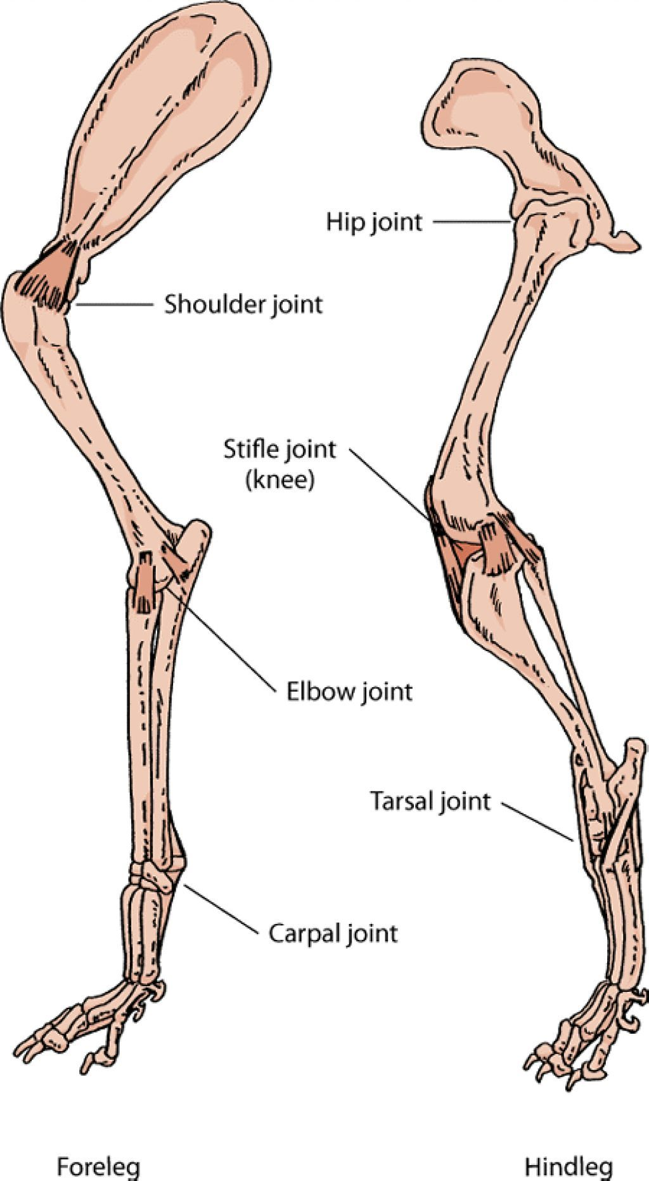
UNIT-2 Fore limb: Joints of the Forelimb
Shoulder Joint:
  Type: Ball and socket
  Bones: Scapula and humerus
  Motion: Flexion, extension, abduction, adduction, rotation
Elbow Joint:
  Type: Hinge
  Bones: Humerus, radius, ulna
  Motion: Flexion, extension, pronation, supination
Carpal Joint:
  Type: Multiple hinge joints
  Bones: Radius, ulna, carpal bones
  Motion: Flexion, extension, lateral movement

Slide 22
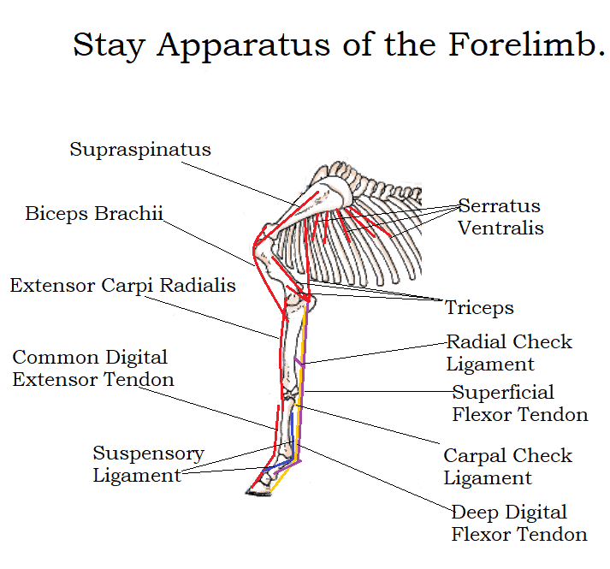
Metacarpophalangeal Joint
Type: Condyloid
Bones: Metacarpal and proximal phalanx
Motion: Flexion, extension
Interphalangeal Joints:
  Type: Hinge
  Bones: Proximal/middle and middle/distal phalanges
  Motion: Flexion, extension
  Stay Apparatus
Suspensory Apparatus:
  Components: Suspensory ligament, proximal sesamoid bones
  Function: Prevents fetlock hyperextension
Check Apparatus:
  Components: Superficial and deep digital flexor tendons
  Function: Limits extension of the digit.

Slide 23
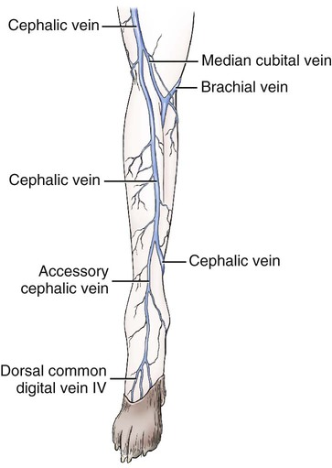
  Major Blood Vessels
Axillary Artery: Supplies blood to the forelimb.
Brachial Artery: Continuation of the axillary artery; supplies the arm.
Median Artery: Supplies the forearm and splits into radial and ulnar arteries.
Radial and Ulnar Arteries: Supply blood to the forelimb and form palmar arches.
Nerves of the Forelimb
Brachial Plexus: Formed by C6-T2 spinal nerves.
Major Nerves: Musculocutaneous, median, ulnar, radial, and axillary nerves.
Veins of the Forelimb
Cephalic Vein: Runs along the lateral aspect; commonly used for venipuncture.
Accessory Cephalic Vein: Drains the dorsal surface
Brachial Vein: Accompanies the brachial artery.
Median Vein: Accompanies the median artery.
Lymph Nodes of the Forelimb
Axillary Lymph Nodes: Drain lymph from the forelimb and thoracic wall.
Cubital Lymph Node: Drains lymph from the distal forelimb.
Superficial Cervical Lymph Nodes: Drain lymph from the proximal forelimb and neck.

Slide 24
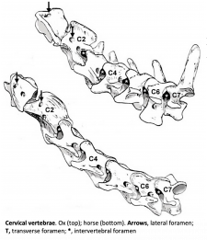
UNIT-3 Head and neck:
Study of cranial and facial bones, cervical vertebrae of ox and differences in horse, dog, pig and fowl. Boundaries of the oral, orbital, nasal and cranial cavities. Study of paranasal sinuses in ox, horse, dog and pig.
Cranial and Facial Bones
Ox: Large cranial cavity; robust maxilla for chewing.
Horse: Prominent frontal bone; elongated facial structure with developed sinuses.
Dog: Rounded skull; pronounced nasal region; shorter snout.
Pig: Flat skull profile; prominent maxillary bones; large nasal openings.
Fowl: Lightweight skull; beak structure; lacks many mammalian bones.
Cervical Vertebrae
All Species: Typically have 7 cervical vertebrae.
Ox: Robust structures for heavy head support.
Horse: Flexible neck for grazing.
Dog: Slender vertebrae for agility.
Pig: Intermediate robustness.
Fowl: Varies (up to 25); allows extensive head movement.

Slide 25
Cavity Boundaries
Oral Cavity: Bounded by lips (anterior), hard palate (superior), soft palate (posterior).
Orbital Cavity: Formed by frontal, zygomatic, and maxillary bones.
Horse: Complete bony circle.
Dog: Orbital ligament laterally completes it.
Nasal Cavity: Extends from nostrils to choanae; divided into vestibule, respiratory, olfactory regions.
Cranial Cavity: Encloses the brain; formed by cranial bones.
Paranasal Sinuses
Ox: Complex frontal sinus; less developed maxillary sinuses at maturity.
Horse: Multiple sinuses (rostral/caudal maxillary, frontal, conchal).
Dog: Less developed maxillary sinus; primarily a recess.
Pig: Similar to dogs; includes lacrimal and sphenoidal sinuses.
Study of articulations and special ligaments of the head and neck. Muscles of face, mastication, eye, ear, tongue, pharynx, soft palate,hyoid and larynx. Study of teeth, hard and soft palate, tongue, pharynx, larynx, thyroid, parathyroid and salivary glands and differences in horse, dog, pig and fowl.

Slide 26
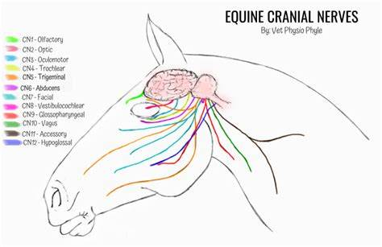
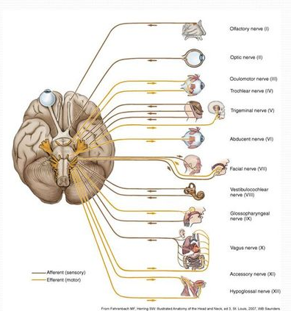
Cranial Nerves
I. Olfactory Nerve: Sense of smell.
II. Optic Nerve: Vision.
III. Oculomotor Nerve: Eye movement and pupil constriction.
IV. Trochlear Nerve: Innervates superior oblique muscle of the eye.
V. Trigeminal Nerve: Facial sensation and mastication (three branches).
VI. Abducens Nerve: Lateral eye movement.
VII. Facial Nerve: Facial expression and taste from anterior tongue.
VIII. Vestibulocochlear Nerve: Hearing and balance.
IX. Glossopharyngeal Nerve: Taste from posterior tongue; swallowing.
X. Vagus Nerve: Controls heart, lungs, digestive tract; swallowing and voice.
XI. Accessory Nerve: Neck muscle control (head rotation).
XII. Hypoglossal Nerve: Tongue movements.

Slide 27
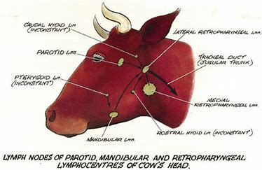
Blood Vessels
Common Carotid Arteries: Bifurcate into internal and external carotid arteries.
External Carotid Artery: Supplies blood to face and neck (multiple branches).
Internal Carotid Artery: Supplies blood to the brain.
Vertebral Arteries: Contribute to intracranial blood supply.
Jugular Veins: Major veins; internal jugular collects blood from brain; external jugular drains superficial structures.
Lymph Nodes
Superficial Lymph Nodes:
  Submental nodes: Chin drainage.
  Submandibular nodes: Cheeks/lips/gums drainage.
  Parotid nodes: Nasal cavity/lateral orbit drainage.
Deep Lymph Nodes: Deep cervical nodes along internal jugular vein.

Slide 28
Jugular Furrow
Bounded by sternocleidomastoid muscle (lateral) and trachea (medial).
Contains internal jugular vein and common carotid artery.
Carotid Sheath
Encases common carotid artery, internal jugular vein, vagus nerve (CN X).
Neck Muscles
Sternocleidomastoid Muscle: Rotates and flexes the head.
Scalene Muscles: Elevate ribs during respiration.
Platysma Muscle: Aids in facial expressions.
Sense Organs
Eyes (vision) controlled by cranial nerves III, IV, VI.
Ears (hearing/balance) controlled by cranial nerve VIII.

Slide 29
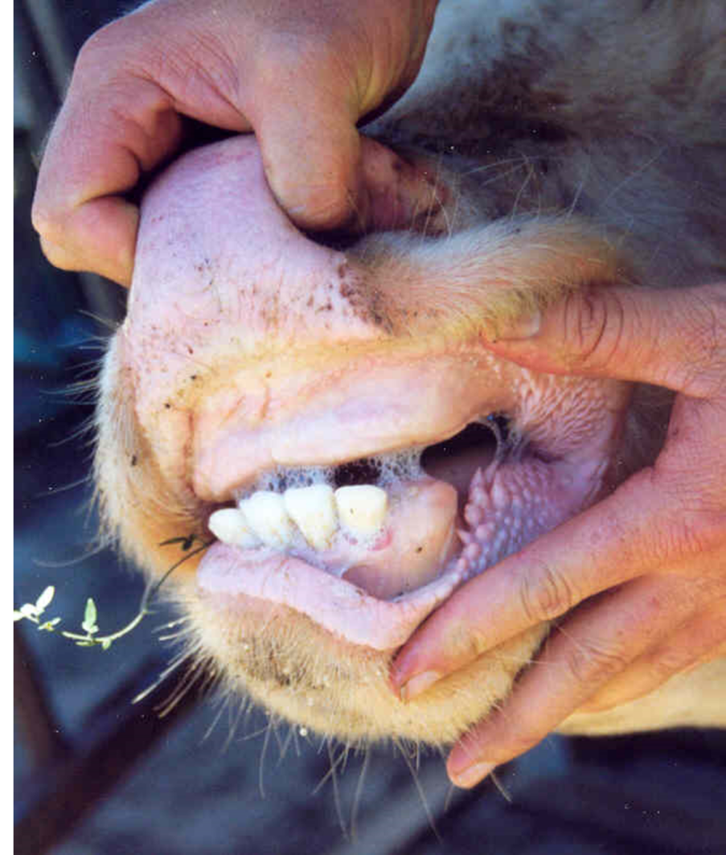
Trachea and Esophagus
Trachea: Conducts air to lungs; reinforced with cartilage rings.
Esophagus: Muscular tube for food transport via peristalsis.
Age determination by Dentition
Importance of Cornual nerve and superficial Temporal artery in Amputation of Horn in cattle.
1. Age Determination by Dentition
Deciduous Teeth:
First set of teeth (milk teeth).
Erupt between 2 to 6 weeks of age.
Permanent Teeth:
Replace deciduous teeth.
Start erupting around 6 months of age.
Eruption Patterns:
Central incisors: Erupt at 1.5 to 2 years.
Lateral incisors: Erupt at 2 to 2.5 years.
Medial incisors: Erupt at about 3 years.
Corner incisors: Erupt between 3.5 to 4 years.

Slide 30
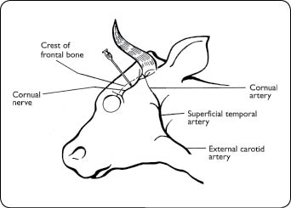
Wear Patterns:
Degree of wear increases with age due to grazing.
Occlusal surface examination helps estimate age.
Dental Formula for Adults:
2 I 1/4 C 0/0 P 3/3 M 3/3)2 I 1/4 C 0/0 P 3/3 M 3/3)
2. Importance of Cornual Nerve in Horn Amputation
Cornual Nerve Block:
Local anesthetic injection near the base of the horn.
Reduces pain during dehorning.
Anatomical Location:
Branch of the zygomaticotemporal nerve supplying sensation to the horn area.
Benefits:
Lowers cortisol response, reducing stress in calves.
Improves recovery and reduces behavioral distress post-procedure.

Slide 31
3. Importance of Superficial Temporal Artery
Role in Blood Supply:
Supplies blood to the scalp and areas around the horns.
Considerations During Surgery:
Avoid damage to prevent excessive bleeding during dehorning.
Hemostasis Management:
Essential for controlling bleeding; may involve ligation or cauterization techniques.

Slide 32
Sites for Tracheotomy, Esophagotomy, Ligation of Stensons duct and Mental, Mandibular, Maxillary, Cornual, Infraorabital, Supraorbital (frontal), Orbital and Auriculopalpebral nerve blocks and surgical approach to guttural pouches in horse.
Surgical Procedures
Tracheotomy:
Site: Between the 2nd and 4th tracheal rings.
Purpose: Establish airway in cases of obstruction.
Esophagotomy:
Site: Cervical region, usually on the left side.
Purpose: Remove foreign bodies or treat esophageal lesions.
Ligation of Stenson's Duct:
Site: Near the second maxillary molar.
Purpose: Manage sialorrhea or parotid duct injuries.
Nerve Blocks
Mental Nerve Block:
Location: Mental foramen.
Indication: Anesthesia of lower lip and chin.
Mandibular Nerve Block:
Location: Near mandibular foramen.
Indication: Anesthesia of entire mandible.
Maxillary Nerve Block:
Location: Near maxillary tuberosity.
Indication: Anesthesia of upper jaw and teeth.
Cornual Nerve Block:
Location: Base of the horn in cattle.
Indication: Anesthesia for horn procedures.

Slide 33
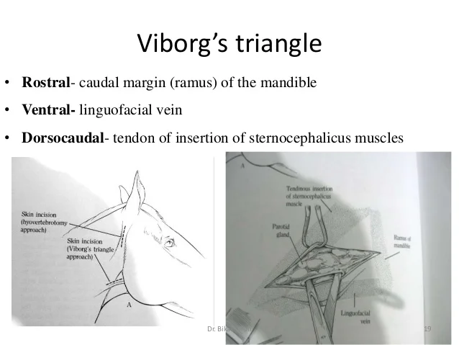
Infraorbital Nerve Block:
Location: Infraorbital foramen.
Indication: Anesthesia of upper lip, nose, and part of the face.
Supraorbital (Frontal) Nerve Block:
Location: Supraorbital foramen.
Indication: Anesthesia of forehead and upper eyelid.
Orbital Nerve Block:
Location: Around the orbit.
Indication: Anesthesia for ocular procedures.
Auriculopalpebral Nerve Block:
Location: Base of the ear.
Indication: Anesthesia of eyelids and surrounding areas.
Surgical Approach to Guttural Pouches in Horses
Viborg’s Triangle Approach:
Defined by:
Ramus of the mandible (ventrally).
Sternocephalicus muscle (medially).
Linguofacial vein (laterally).
Purpose: Access to guttural pouches for drainage or surgical intervention.

Slide 34
UNIT-4
Study of thoracic vertebrae, ribs and sternum of ox and differences in horse, dog, pig and fowl.
Study of joints, special ligaments, blood vessels, nerves, lymph vessels and lymph nodes of thorax.
Joints of the Thorax
Costovertebral Joints: Connect ribs to thoracic vertebrae; allow slight movement during respiration.
Costotransverse Joints: Connect rib tubercles to transverse processes; facilitate rib movement.
Sternocostal Joints: Connect costal cartilages of true ribs to sternum; minimal movement.
Interchondral Joints: Between costal cartilages of adjacent ribs; allow slight movement.
Special Ligaments in the Thorax
Anterior Longitudinal Ligament: Stabilizes vertebral bodies; resists extension.
Posterior Longitudinal Ligament: Supports intervertebral discs; resists hyperflexion.
Ligamentum Flavum: Connects adjacent laminae; maintains spinal curvature.
Supraspinous Ligament: Connects spinous processes; supports spinal extension.
Interspinous Ligaments: Stabilize adjacent spinous processes.

Slide 35
Blood Vessels in the Thorax
Great Vessels: Include aorta, pulmonary arteries, superior/inferior vena cavae; transport blood.
Pulmonary Circulation: Carries deoxygenated blood to lungs and oxygenated blood back to heart.
Systemic Circulation: Aorta distributes oxygen-rich blood to body; intercostal arteries supply thoracic structures.
Nerves in the Thorax
Thoracic Spinal Nerves: Provide motor/sensory innervation to thoracic muscles and skin.
Intercostal Nerves: Innervate intercostal muscles for respiration.
Vagus Nerve (Cranial Nerve X): Controls heart rate and respiratory function.
Sympathetic Chain Ganglia: Provides sympathetic innervation to thoracic organs.
Lymph Vessels in the Thorax
Lymphatic System: Transports lymph fluid; filters pathogens.
Thoracic Duct: Drains lymph from most of the body into venous circulation.
Right Lymphatic Duct: Drains lymph from right upper quadrant into venous circulation.

Slide 36
Lymph Nodes in the Thorax
Function: Filter lymph fluid; contain immune cells (T cells, B cells).
Major Nodes:
  Mediastinal Nodes: Filter lymph from thoracic organs (lungs, heart).
  Axillary Nodes: Receive lymph from upper limbs; important for immune response.
Clinical Relevance
Swollen lymph nodes can indicate infection or malignancy.
Knowledge of thoracic anatomy is crucial for diagnosis and treatment in veterinary practice.
Study of organs of thorax i.e. trachea, thymus, oesophagus, lungs and differences in horse, dog, pig and fowl.
Study of pleura, its reflections and mediastinum. Areas of auscultation and percussion of heart and lungs and site for Paracentesis Thoracis.
1.Pleura
Definition: Serous membrane lining the thoracic cavity and covering the lungs.
Layers:
  Parietal Pleura: Lines thoracic wall and diaphragm.
  Visceral Pleura: Covers lung surfaces.

Slide 37
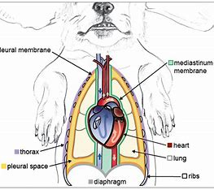
Reflections: Occur at the hilum of the lung and where costal pleura becomes mediastinal pleura.
Function:
  Reduces friction during respiration.
  Facilitates lung movement.
  Creates negative pressure for lung expansion.
2. Mediastinum
Definition: Central compartment separating left and right pleural cavities.
Divisions:
  Cranial Mediastinum: Contains trachea, oesophagus, thymus, major blood vessels, lymph nodes.
  Middle Mediastinum: Houses heart, main pulmonary artery, aorta, azygos vein, thoracic duct.
  Caudal Mediastinum: Contains descending aorta, caudal vena cava, oesophagus, vagus nerve.
  Function: Conduit for nerves and blood vessels; provides structural support.

Slide 38
3. Areas of Auscultation
Cardiac Auscultation Areas:
  Aortic Area: Right second intercostal space (ICS).
  Pulmonic Area: Left second ICS.
  Tricuspid Area: Left sternal border (third to sixth ICS).
  Mitral Area: Fifth ICS at midclavicular line.
Lung Auscultation: Systematic grid pattern to assess lung sounds; abnormal sounds indicate conditions like pneumonia.
Percussion: Assesses lung density; not routinely performed in small animals.
4. Site for Paracentesis Thoracis
Definition: Procedure to remove fluid or air from the pleural space.
Site Selection: Typically in the seventh to eighth intercostal space on the right side.
Procedure Considerations:
  Use aseptic technique to prevent infection.
  Monitor for complications such as pneumothorax or bleeding.

Slide 39
UNIT 5
ABDOMEN

Slide 40
Blood Supply to Abdominal Viscera
Celiac Trunk: Supplies liver, stomach, spleen (common in all species).
Superior Mesenteric Artery: Supplies small and part of large intestine.
Inferior Mesenteric Artery: Supplies distal large intestine.
Venous Drainage:
  Ox, Horse, Dog, Pig: Inferior vena cava; hepatic portal vein drains GI tract.
  Fowl: Limited vascularization; relies on hepatic portal vein.
Sympathetic Supply: Via splanchnic nerves from thoracic/lumbar spinal nerves.
Parasympathetic Supply:
Vagus Nerve: Innervates most abdominal organs (common in all species).
Pelvic Splanchnic Nerves: Innervate lower digestive system.
Nerve Supply to Abdominal Viscera

Slide 41
Peritoneal Reflections
Parietal Peritoneum: Lines abdominal wall; supplied by abdominal wall vessels.
Visceral Peritoneum: Covers organs; receives blood from associated viscera.
Key Reflections:
  Mesentery: Attaches intestines to posterior abdominal wall.
  Omentum: Connects stomach to other organs (greater and lesser).
Digestive System Organs
Ox | Horse | Dog | Pig | Fowl
Ruminant stomach (4 compartments: rumen, reticulum, omasum, abomasum) | Single-chamber stomach Large cecum for fermentation | Simple stomach Shorter intestines | Simple stomach More complex due to omnivorous diet | No true stomach Has gizzard for grinding food

Slide 42
Similar kidney structure across species.
Varying bladder sizes:
Ox and pig have larger bladders.
Dog has a smaller bladder.
Fowl has a very small bladder.
Urinary System Organs
Male Reproductive Organs
Female Reproductive Organs
Ox: Larger testes; developed epididymis and
ductus deferens.
Horse: Moderate-sized testes; similar structures as ox.
Dog and Pig: Smaller testes; similar structures as horse.
Fowl: Smaller reproductive organs.
Ox: Larger ovaries; developed uterine horns.
Horse: Smaller ovaries; less developed uterine horns.
Dog and Pig: Smaller ovaries; simple uterine structure.
Fowl: Small ovaries; simple reproductive tract

Slide 43
Mammary Glands
Bovine (Cow) | Mare | Bitch | Sow
Four quarters with separate glands and teats. Functional unit: alveolus for milk synthesis. Supported by connective tissue and median suspensory ligament. | Less pronounced lobular structure than cows. Composed of terminal duct lobular units. Lower milk production compared to cows. | Typically 8-10 teats; similar to human structure. Significant changes during the estrous cycle and lactation. Susceptible to mastitis and tumors. | 12-14 teats arranged in two rows. Structure similar to bitches; adapted for larger litters. Also prone to mastitis and infections.
Spleen
Ox:
  Elongated and flat; located on the left side of the abdomen.
  Functions: blood filtration, iron recycling, lymphocyte production.

Slide 44
Horse:
  Smaller relative to body size; rounded shape.
  Significant role in blood filtration during exercise.
Dog:
  Smaller and elongated; less prominent than in ruminants.
  Similar functions but lower blood storage capacity.
Pig:
  Larger than in dogs; extensive vascular supply.
  Important for immune function.
Fowl:
  Small and oval-shaped; limited blood storage capability.
  Plays a role in immune response.

Slide 45
Major Veins and Lymphatic System
Major Veins:
  Caudal vena cava: Drains lower body into the heart.
  Hepatic portal vein: Drains gastrointestinal tract blood to the liver.
Lymphatic Vessels:
  Network transporting lymph fluid from tissues back to bloodstream.
Lymph Nodes:
  Filters for lymph fluid; contain immune cells.
  Key nodes include mesenteric (gut immunity) and popliteal (hind limb drainage).
Endocrine Glands of the Abdomen
Pancreas | Adrenal Glands | Thyroid Gland
Exocrine (digestive enzymes) and endocrine (insulin production) functions | Produce hormones like cortisol and adrenaline Involved in stress response. | Regulates metabolism through hormone production Associated lymphatic drainage

Slide 46
Boundaries and Clinical importance of the flank and Para Lumbar Fossa
Boundaries of the Flank
Dorsal: Lumbar vertebrae (transverse processes).
Ventral: Linea alba (midline of the abdomen).
Cranial: Last rib.
Caudal: Tuber coxae (hip bone)
Boundaries of the Para Lumbar Fossa
Dorsal: Lumbar transverse processes.
Ventral: Internal abdominal oblique muscle.
Cranial: Last rib.
Caudal: Tuber coxae.
Clinical Importance
Surgical Access: Common site for abdominal surgeries
Diagnostic Procedures:
  Exploratory laparotomy for abdominal conditions.
  Rumenocentesis to assess rumen health.
  Liver biopsy for diagnosing liver diseases.
Anesthesia Techniques: Paravertebral block for flank surgeries.
Sites for Surgical Procedures
Liver Biopsy: Right flank or paralumbar fossa.
Gall Bladder Biopsy: Right-sided approach during laparotomy.
Caecal Biopsy: Right flank incision.
Laparotomy: Left or right flank incision for abdominal exploration.
Rumenocentesis: Needle insertion through left paralumbar fossa.
Rumenotomy: Access through left paralumbar fossa.
Abomasotomy: Right flank access to the abomasum.
Spleenectomy: Left flank incision for spleen removal.
Cystotomy: Ventral midline or flank incision for urinary bladder access.
Caesarean Operation: Left or right flank incision based on fetal position.
Enterotomy: Midline or flank incision to open the intestine.

Slide 47
UNIT 6
HIND LIMB AND PELVIS

Slide 48
JOINTS
Hip Joint | Stifle Joint | Tarsal Joints | Metatarsophalangeal Joint
Formed by acetabulum and femoral head Wide range of motion | Composed of femur, tibia, patella Hinge joint for flexion/extension | Multiple joints in hock region Limited movement but stable | Connects metatarsals to phalanges Flexion/extension of toes
Ligaments
Ligamentum teres | Cruciate ligaments | Collateral ligaments | Suspensory ligament
Connects femoral head to acetabulum | Stabilize stifle joint; anterior and posterior | Provide stability to joints like stifle and hock | Supports metatarsals in horses
Blood Vessels
Femoral Artery | Popliteal Artery | Femoral Vein
Main hind limb artery Branches into popliteal | Bifurcates into anterior and posterior tibial arteries | Drains blood from hind limb back to heart

Slide 49
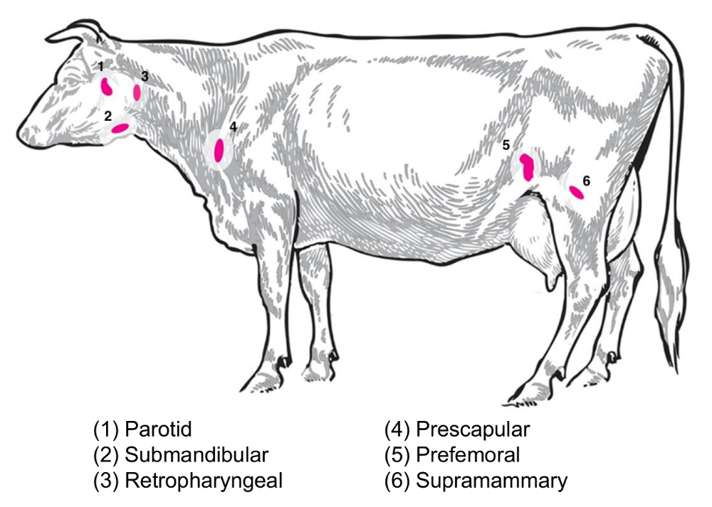
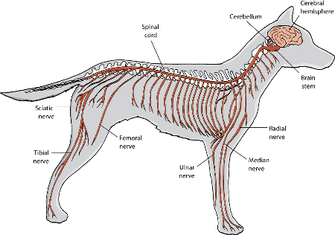
Lymph Nodes
Popliteal Lymph Nodes: Drain hind limb lymph; located
behind stifle.
Iliac Lymph Nodes: Drain pelvic organs; near iliac arteries.
Lumbar Lymph Nodes: Receive lymph from abdominal organs
; along lumbar vertebrae.
Nerves
Sciatic Nerve: Largest nerve; innervates hind limb muscles.
Femoral Nerve: Supplies quadriceps; important for stifle
extension.
Tibial Nerve: Branches from sciatic nerve; innervates lower
leg muscles.
Pelvic Viscera
Bladder: Stores urine; innervated by autonomic nerves.
Female Reproductive Organs: Ovaries, uterus, vagina.
Male Reproductive Organs: Testes, prostate gland.

Slide 50
Boundaries of the inguinal canal and structures of the spermatic cord, pre pubic tendon and its importance
Inguinal Canal
Definition: An oblique passage through the abdominal wall in the inguinal region.
Location: Extends from the deep inguinal ring to the superficial inguinal ring.
Boundaries : Deep Inguinal Ring:
  Bordered cranially by the internal abdominal oblique muscle.
  Ventromedially by the rectus abdominis muscle and prepubic tendon.
  Caudally by the inguinal ligament.
Superficial Inguinal Ring:
  Formed by a slit in the aponeurosis of the external abdominal oblique muscle.
Boundary | Description
Superior Wall (Roof) | Formed by internal oblique and transversus abdominis muscles
Anterior Wall | Composed of aponeuroses (external and internal oblique)
Posterior Wall | Formed by transversalis fascia and conjoint tendon
Inferior Wall (Floor) | Formed by inguinal ligament and lacunar ligament

Slide 51
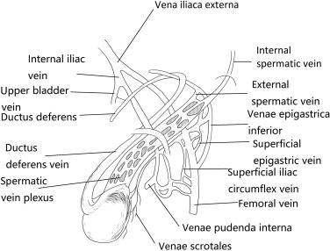
Structures of the Spermatic Cord
Testicular Artery: Supplies blood to the testes.
Pampiniform Plexus: Vein network that cools arterial blood.
Vas Deferens (Ductus Deferens): Transports sperm to urethra.
Cremasteric Artery: Supplies blood to cremaster muscle.
Nerves: Includes genital branch of genitofemoral nerve and sympathetic fibers.
Fascial Layers: External Spermatic Fascia: From external abdominal oblique muscle.
  Cremasteric Fascia: From internal abdominal oblique muscle.
  Internal Spermatic Fascia: From transversalis fascia.
Prepubic Tendon : Fibrous structure at the ventral aspect of the pelvis.
Importance: Provides support to abdominal muscles during locomotion.
  Acts as a site for muscular attachment for pelvic stability.
  Maintains structural integrity during stress on pelvic region.
Clinical Significance
Essential for surgical procedures such as castration and hernia repairs.
Aids in diagnosing conditions like inguinal hernias.
Important for managing reproductive health issues in domestic animals.

Slide 52
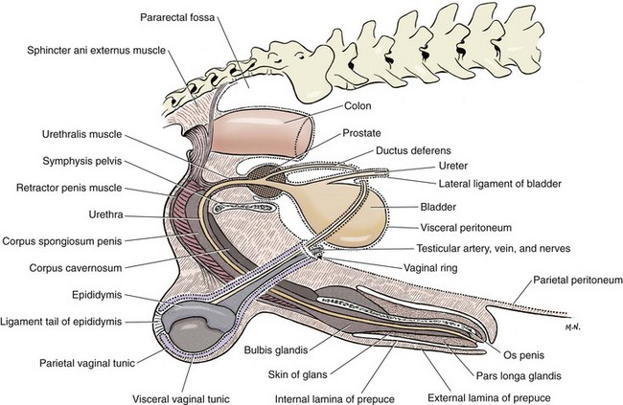
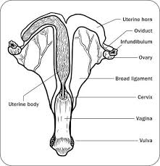
Study of external genital organs
External Genital Organs
Male: Penis - External organ for urination and copulation.
Prepuce: Skin fold covering the penis.
Scrotum: Pouch containing the testes.
Female: Vulva - External opening of the female reproductive tract.
Clitoris: Sensitive structure at the anterior vulva.
Labia: Folds of skin on either side of the vulva.
Nerve Block Sites
Tibial Nerve Block: Location - Tarsal joint.
  Effect: Anesthetizes plantar aspect of hind limb and digits.
Peroneal Nerve Block: Location - Stifle joint.
  Effect: Anesthetizes dorsal aspect of hind limb and digits.
Pudic Nerve Block: Location - Via rectum or vagina.
Effect: Anesthetizes external genitalia and perineal region

Slide 53
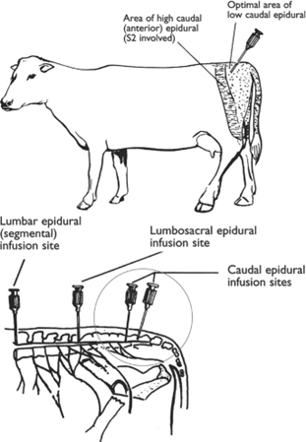
Surgical Procedures
Patellar Desmotomy: Procedure to release the patellar ligament; treats upward fixation of the patella.
Urethrotomy: Incision into the urethra; used to remove urinary calculi or treat obstructions.
Castration: Surgical removal of testes; prevents breeding and reduces testosterone.
Vasectomy: Surgical interruption of vas deferens; sterilizes males without removing testes.
Epidural Anesthesia
Cranial Epidural Anesthesia:
  Location: Between first and second lumbar vertebrae.
  Effect: Anesthetizes perineal region and hindquarters.
Caudal Epidural Anesthesia:
  Location: Between last sacral and first coccygeal vertebrae.
  Effect: Anesthetizes perineal region and tail.

Slide 54
UNIT 7 - CYTOLOGY
Definition: Study of cells and their structures
Key Components: Membrane, cytoplasm, organelles (nucleus, mitochondria)
Function: Cell-specific roles in tissue health
Cell Junctions
Purpose: Connect cells, maintain tissue integrity, facilitate communication

Slide 55
Types of Cell Junctions
1.Tight Junctions:
Barrier to regulate substance passage
Composed of claudins and occludins
2. Adherens Junctions:
Connect actin filaments; provide mechanical strength
Involve E-cadherin
3. Desmosomes:
Strong adhesion in mechanically stressed tissues
Connect intermediate filaments
4. Gap Junctions:
Direct communication via channels for ions/molecules

Slide 56


Basic Tissue Types
1. Epithelial Tissue
2. Connective Tissue
Function: Covers surfaces; involved in absorption/secretion
Characteristics: Tightly packed cells; simple or stratified layers
Function: Supports/binds tissues; stores energy
Components: Cells (fibroblasts), extracellular matrix (collagen, elastin)
Types: Loose, dense, adipose, blood

Slide 57
Contd…
3. Muscular Tissue
4. Nervous Tissue
Function: Movement
Types:
Skeletal: Voluntary, striated
Cardiac: Involuntary, striated with intercalated discs
Smooth: Involuntary, non-striated
Function: Transmits impulses for communication
Components:
• Neurons: Signal transmission.
• Glial cells: Support neurons

Slide 58
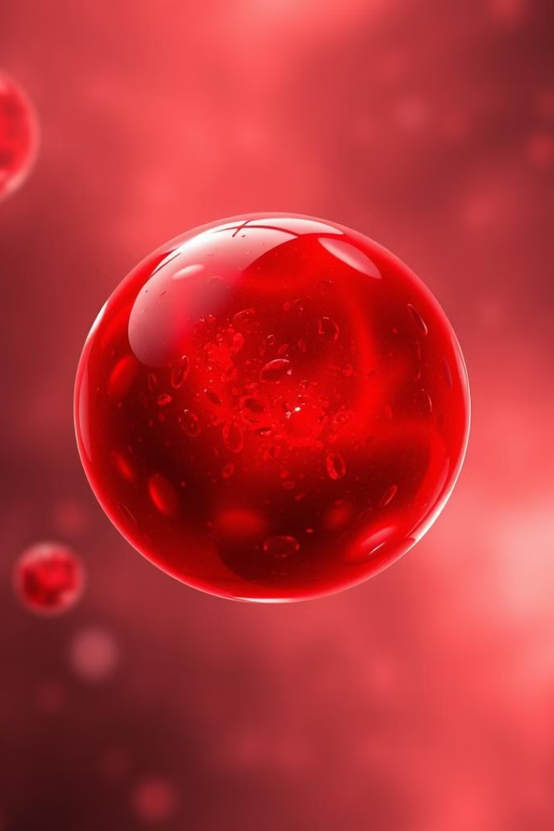
Blood Composition
1
Red blood cells
(carry oxygen).
2
White blood cells
(immune response).
3
Platelets
(blood clotting).

Slide 59
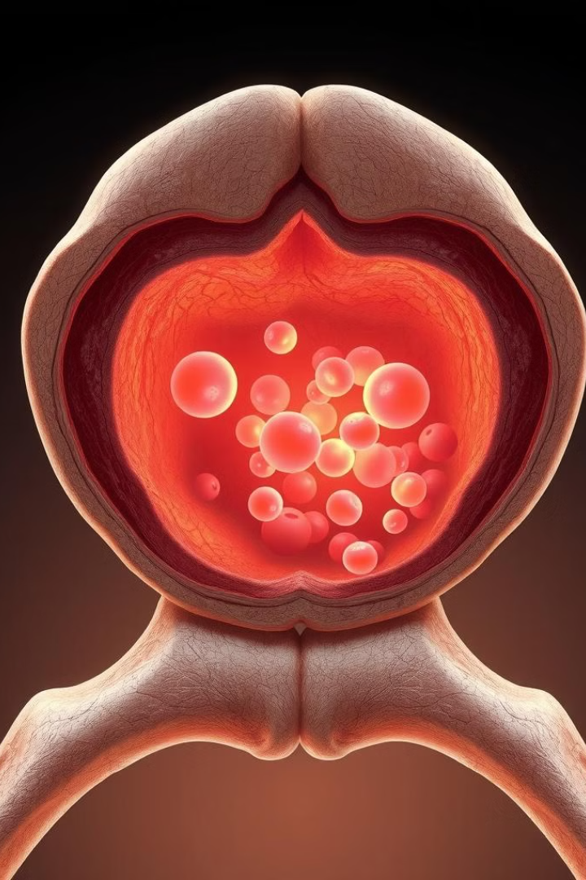


Bone Marrow
Site of haematopoiesis
(blood cell formation)
.
Contains stem cells for various
blood cell types

Slide 60
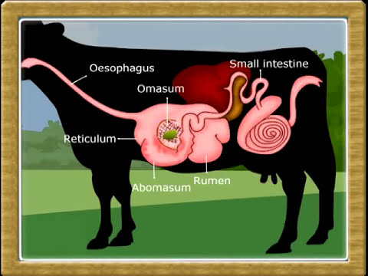
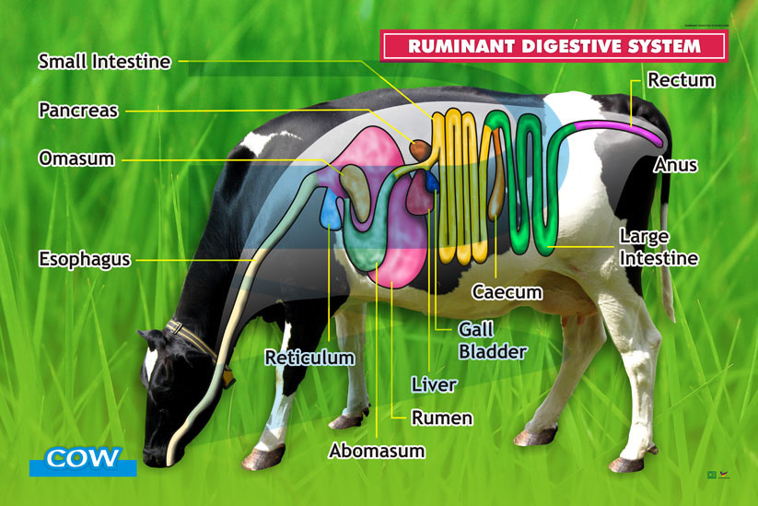
1. Digestive System
Mouth
Begins digestion; salivary glands produce enzymes
Esophagus
Transports food to the stomach
Stomach
Regions: Cardia, fundus, pylorus
Histology: Parietal cells (HCl), chief cells (pepsinogen)
Small Intestine
Segments: Duodenum, jejunum, ileum
Features: Villi and microvilli for absorption; enterocytes and goblet cells
Large Intestine
Water absorption and faeces formation

Slide 61
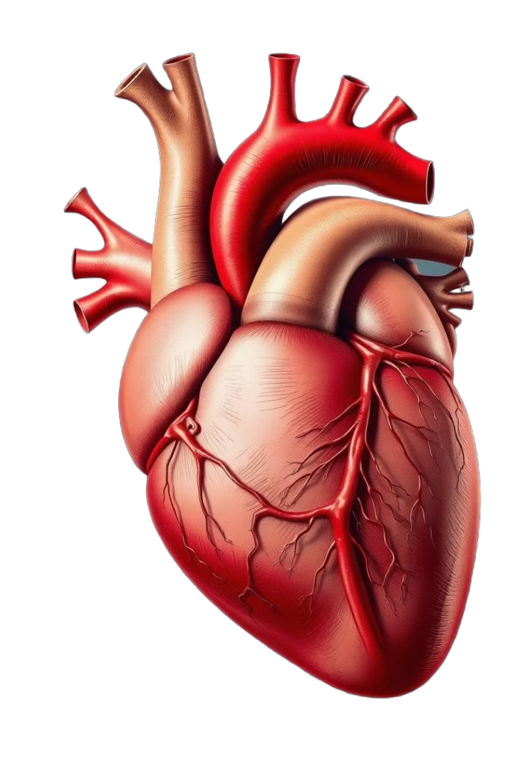
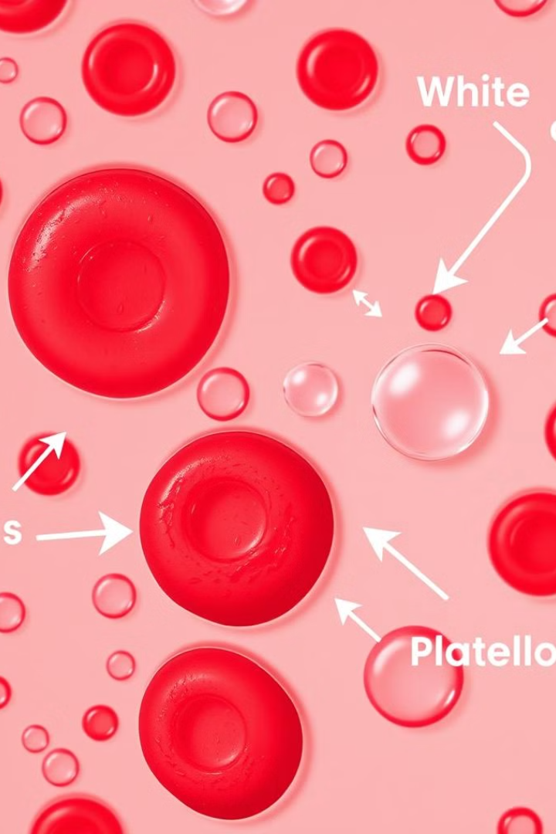
2. Circulatory System
Heart:
Four chambers (two atria, two ventricles)
Blood Vessels:
Arteries: Carry oxygenated blood
Veins: Return deoxygenated blood
Capillaries: Site of nutrient/gas exchange
Blood Composition:
Red blood cells (oxygen transport)
White blood cells (immune response)
Platelets (clotting)

Slide 62
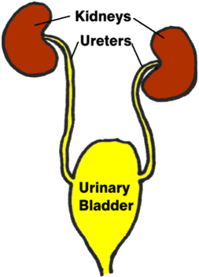
3. Urinary System
• Kidneys: Filter blood; contain nephrons for urine production
• Ureters: Transport urine from kidneys to bladder
• Bladder: Stores urine
• Urethra: Conducts urine out of the body

Slide 63
4. Respiratory System
Nasal Cavity:
Trachea/
Bronchi:
Lungs
Alveoli facilitate gas exchange
Filters and humidifies air
Conduct air; lined with ciliated epithelium

Slide 64
5. Nervous System
CNS:
Comprises brain and spinal cord
PNS:
Sensory and motor neurons connecting CNS to body
Neurons: Transmit impulses; consist of dendrites, cell body, axon
Fruits
6. Lymphatic System
Components: Lymph nodes: Filter lymph; house immune cells.
Lymphatic vessels: Transport lymph.
Spleen: Filters blood; involved in immune responses.

Slide 65
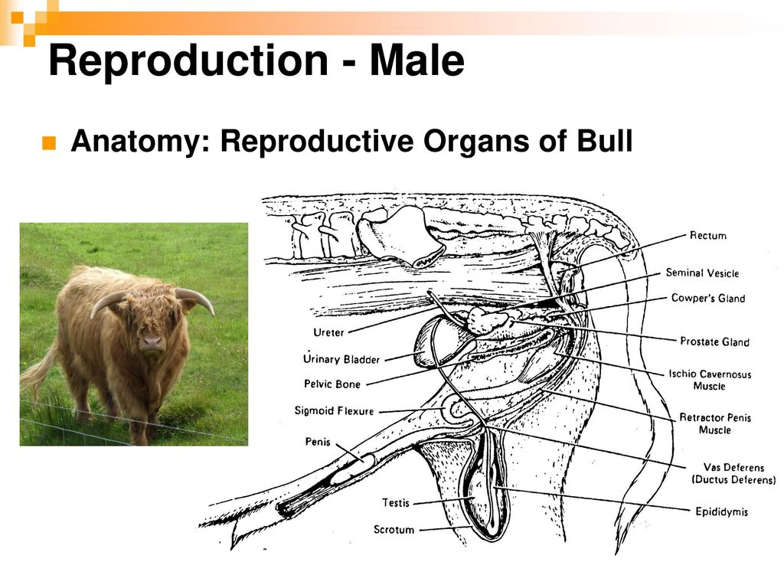

7. Endocrine System
Glands: Pituitary gland: Master gland for hormone regulation.
Thyroid gland: Regulates metabolism.
Adrenal glands: Produce stress-related hormones.
8. Male Genital System
Testes: Produce sperm and testosterone.
Accessory Glands: Contribute fluids to semen (seminal vesicles, prostate).
9. Female Genital System
Ovaries: Produce ova and hormones (estrogen, progesterone).
Oviducts: Transport ova; site of fertilization.
Uterus: Site for fetal development.
Vagina: Birth canal; receives sperm.
10. Mammary Glands
Structure: Composed of alveoli lined with milk-secreting epithelial cells.
Functionality varies by species; involved in milk production during lactation.

Slide 66


Microscopic Structure of Sense Organs
Eye
Sclera: Tough outer layer providing protection.
Cornea: Transparent front part that refracts light.
Iris: Regulates light entry through the pupil.
Pupil: Adjustable opening for light control.
Lens: Focuses light onto the retina; changes shape for distance.
Retina: Contains photoreceptors (rods and cones) that convert light into signals.
Microscopic Features
Rods: Sensitive to low light; night vision.
Cones: Responsible for color vision and detail.
Optic Nerve: Transmits visual information to the brain.
Pigment Epithelium: Nourishes photoreceptors and absorbs excess light.
Ear
Outer Ear: Pinna (Auricle): Collects sound waves.
External Auditory Canal: Channels sound to the tympanic membrane.
Middle Ear: Tympanic Membrane: Vibrates with sound waves.
Auditory Ossicles: Amplify sound (malleus, incus, stapes).
Inner Ear: Cochlea: Contains hair cells for sound conversion.
Vestibular System: Maintains balance.
Microscopic Features
Hair Cells: Sensory receptors in the cochlea.
Organ of Corti: Contains hair cells crucial for hearing.
Membranous Labyrinth: Fluid-filled structures for balance and hearing.

Slide 67

Integument
Epidermis: Stratified squamous epithelium; waterproof barrier.
Dermis: Connective tissue with blood vessels, nerves, and glands.
Hypodermis (Subcutaneous Layer): Loose connective tissue; insulates body.
Microscopic Features
Keratinocytes: Produce keratin for protection.
Melanocytes: Produce melanin for pigmentation and UV protection.
Sebaceous Glands: Secrete sebum to lubricate skin and hair.
Sweat Glands: Regulate body temperature through perspiration.
Importance
Aids in disease diagnosis and treatment.
Essential for surgical interventions involving sense organs.
Enhances veterinary care through understanding sensory functions.
Supports research advancements in veterinary medicine.

Slide 68
UNIT 8
INTRODUCTION TO EMBRYOLOGY

Slide 69

Introduction
Embryology: Study of embryo development from fertilization to birth.
Importance: Understanding developmental processes and abnormalities.
Gametogenesis
Definition: Production of gametes (sperm and eggs).
Types: Spermatogenesis: Formation of sperm in testes.
Oogenesis: Formation of ova in ovaries.
Process: Involves meiosis; regulated by hormones.
Fertilization
Definition: Fusion of sperm and egg to form a zygote.
Process: Sperm penetrates egg layers.
Genetic material combines, forming a diploid zygote.
Cleavage
Definition: Rapid mitotic divisions after fertilization.
Characteristics: Zygote divides into blastomeres.
Lack of growth; cells remain small.
Types: Holoblastic: Complete division (e.g., mammals).
Meroblastic: Partial division (e.g., birds).

Slide 70
Types of Eggs
Oligolecithal: Minimal yolk (mammals); holoblastic cleavage.
Mesolecithal: Moderate yolk (amphibians); unequal cleavage.
Telolecithal: Abundant yolk (birds); meroblastic cleavage.
Isolecithal: Even yolk distribution; echinoderms.
Morula
Definition: Solid ball of cells (16 to 32 blastomeres).
Significance: Precedes the blastula stage.
Blastulation
Definition: Transformation from morula to blastula with a blastocoel.
Characteristics: Outer layer forms trophoblast for placenta.
Inner cell mass develops into the embryo.
Gastrulation
Definition: Formation of three germ layers from the blastula.
Germ Layers: Ectoderm: Skin and nervous system.
Mesoderm: Muscles, bones, circulatory system.
Endoderm: Internal organs (gut, lungs).
Types of Implantation
Ectopic Implantation: Occurs outside the uterus; can be dangerous.
Endometrial Implantation: Normal implantation in the uterine lining.
Types of Endometrial Implantation
Interstitial Implantation: Embryo embeds in uterine wall (e.g., humans).
Decidual Implantation: Significant maternal tissue remodeling (e.g., rodents).
Superficial Implantation: Attaches without deep invasion (e.g., pigs).

Slide 71

Twinning
Definition: Development of two embryos simultaneously.
Types of Twinning
Dizygotic (Fraternal): Two separate eggs fertilized by two sperm.
Genetically distinct individuals.
Monozygotic (Identical):
Single fertilized egg splits into two embryos.
Genetically identical individuals.
Formation of Fetal Membranes
Amnion: Fluid-filled sac around the embryo.
Provides cushioning and protection.
Maintains stable temperature.
Chorion: Outermost membrane surrounding the embryo.
Involved in gas exchange.
Contributes to placenta formation in mammals.
Allantois: Stores waste and facilitates gas exchange.
Forms blood vessels for the umbilical cord in mammals.
Yolk Sac: Provides early nourishment to the embryo.
Contains yolk as a nutrient source in birds.

Slide 72

Placenta
Definition: Organ that facilitates nutrient and gas exchange between mother and fetus.
Classification by Layers: Epitheliochorial: All six tissue layers intact (e.g., pigs, horses).
Syndesmochorial: Maternal epithelium absent (e.g., ruminants).
Endotheliochorial: Maternal connective tissue absent (e.g., dogs, cats).
Hemochorial: Maternal blood in direct contact with chorion (e.g., humans, rodents).
Classification by Shape
Diffuse: Villi distributed over the surface (e.g., pigs, horses).
Cotyledonary: Villi grouped into caruncles (e.g., ruminants).
Zonary: Villi form a band-like zone (e.g., dogs, cats).
Discoidal: Villi form a disc-shaped area (e.g., humans).
Germ Layers
Ectoderm: Outermost layer.
Derivatives: epidermis, nervous system, hair, nails.
2. Mesoderm: Middle layer.
Derivatives: musculoskeletal system, circulatory system, urogenital system.
3. Endoderm: Innermost layer.
Derivatives: lining of gastrointestinal tract, respiratory system, liver, pancreas.

Slide 73
Development of the Digestive System
Embryonic Origins
Endoderm: Origin of the digestive system during gastrulation.
Primitive Gut Tube: Forms from lateral and cephalocaudal folding.
Regions: Divided into foregut, midgut, and hindgut.
Foregut Development
Extends: From oral cavity to duodenum.
Contributes to: Esophagus, Stomach, Duodenum, Liver and biliary apparatus, Pancreas
Blood Supply: Celiac artery.
Midgut Development
Extends: From duodenum to proximal two-thirds of transverse colon.
Contributes to: Small intestine (jejunum, ileum), Cecum, Appendix, Ascending colon
Blood Supply: Superior mesenteric artery.
Hindgut Development
Extends: From distal one-third of transverse colon to cloacal membrane.
Contributes to: Descending colon, Sigmoid colon, Rectum
Blood Supply: Inferior mesenteric artery.

Slide 74

Accessory Structures of the Digestive System
Tongue
Structure: Skeletal muscle covered by mucous membrane.
Functions: Mechanical processing of food.
Sensory analysis (taste, temperature).
Teeth
Types: Incisors, canines, premolars, molars.
Functions: Mechanical breakdown of food through chewing.
Salivary Glands
Major Glands: Parotid: Serous secretions rich in amylase.
Submandibular: Mixture of serous and mucous fluids.
Sublingual: Primarily mucous secretions.
Functions: Moistening and lubricating food.
Initiating digestion with enzymes.
Liver
Structure: Divided into lobes; functional units are liver lobules.
Functions: Produces bile salts for fat emulsification.
Metabolizes carbohydrates, proteins, lipids.
Pancreas
Structure: Endocrine (hormone secretion) and exocrine (digestive enzyme secretion) components.
Functions: Secretes digestive enzymes into the small intestine.
Regulates blood glucose levels through insulin and glucagon.

Slide 75
Development of Organ Systems
1. Respiratory System
Origin: Forms from the foregut; respiratory diverticulum appears around week 4.
Stages: Pseudoglandular (Weeks 6-16): Formation of conducting airways.
Canalicular (Weeks 16-28): Development of respiratory bronchioles; vascularization begins.
Saccular (Weeks 28-36): Formation of terminal sacs (primitive alveoli).
Alveolar (Late Fetal to Early Childhood): Alveoli develop and increase in number.
2. Urinary System
Origin: Derived from the mesoderm (intermediate mesoderm).
Key Features: Develops three kidney systems: pronephros, mesonephros, and metanephros (permanent kidneys).
Metanephros becomes functional around week 10.
3. Circulatory System
Origin: Begins with tubular heart formation by week 3.
Key Features: Heart undergoes looping and septation to form chambers.
Blood vessels develop through vasculogenesis and angiogenesis.

Slide 76
4. Lymphatic System
Origin: Develops from mesodermal lymphangioblasts alongside the circulatory system.
Key Features: Lymphatic vessels sprout from veins.
Lymph nodes form from clusters of lymphoid tissue.
5. Nervous System
Origin: Neural tube forms around week 3 from ectoderm.
Key Features: Neural crest cells migrate to form peripheral nerves and ganglia.
Differentiation into forebrain, midbrain, and hindbrain occurs.
6. Musculoskeletal System
Origin: Derived from mesoderm; somites give rise to muscles and bones.
Key Features: Limb buds appear by week 4, leading to limb development.
7. Reproductive Systems
Male: Develops from mesonephric ducts; testes differentiate around week 7.
Female: Develops from paramesonephric ducts; ovaries differentiate around week 12.

Slide 77


Development of Endocrine Glands
Pituitary Gland: Develops from ectoderm in the oral cavity.
Thyroid Gland: Forms from endoderm at the base of the
tongue.
Adrenal Glands: Composed of mesodermal (cortex) and
neural crest-derived (medulla) tissues.
Development of Sense Organs
Eye
Develops from surface ectoderm and neuroectoderm
around week 4.
Key structures include lenses, retina, and cornea.
Ear
Develops from ectodermal otic placodes around week 4.
Comprises outer ear (pinna), middle ear (ossicles), and
inner ear (cochlea).

Slide 78


